Slide 1
Notes:
Opening Graphic

Slide 2
Next Session
Student Success Center:
The Power of the Force
Notes:
Template Page – Duplicate and use as needed.

Slide 3
Student Success Center = SSC
The Success Center is located on 3rd floor of Davis Hall
Monday – Friday 8am - 4:30pm
Notes:
Template Page – Duplicate and use as needed.

Slide 4
Student Success Center = SSC
Goals
Assist students to define, clarify, and achieve academic, personal, and professional goals.
Enhance students’ success in academic and career exploration to secure that diploma.
Support faculty advisors by helping to develop a student’s academic plan.
Advise students in University College
Notes:
Template Page – Duplicate and use as needed.

Slide 5
Student Success Center = SSC
Who will the SSC work with?
The SSC:
Dedicated to increasing persistence toward degree/certificate completion.
The SSC is open to all VU students, but will specifically target those needing additional guidance and support.
Notes:
Template Page – Duplicate and use as needed.

Slide 6
Student Success Center = SSC
Support Programs
Offer outreach and support to students to increase their likelihood
of academic success.
Help developing collegiate skills such as time management, test taking, and academic skills.
Notes:
Template Page – Duplicate and use as needed.

Slide 7
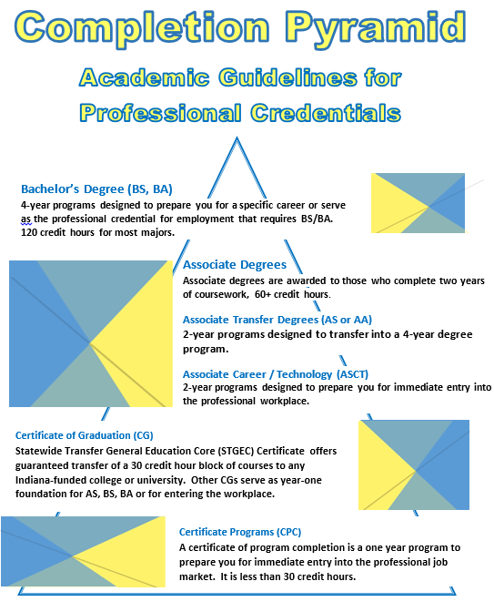
Student Success Center = SSC
Which Path is for you?
Certificate?
Associate Degree Career and
Technical?
Associate Degree Transfer?
Baccalaureate Degree?
Make sure to talk to your advisor today about your options!
Notes:
Template Page – Duplicate and use as needed.

Slide 8
Student Success Center = SSC
If you took dual credit through a college, other than VU, make sure to have your transcripts sent to
Vincennes University
Registrar’s Office
1002 N. First St.
Vincennes, IN 47591
OR
records@vinu.edu
Notes:
Template Page – Duplicate and use as needed.

Slide 9
Student Success Center = SSC
Please join the Student Success Center Texting Program
To the following number: 81010
Text and send this message: @May132017
If asked, respond with your full name.
All done!
Notes:
Template Page – Duplicate and use as needed.

Slide 10
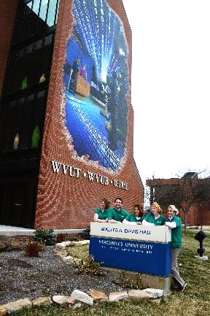
Student Success Center = SSC
Where do you access the Student Success Center?
The Success Center
is located on the
3rd floor of Davis Hall
Hours are
Monday – Friday
8:00am - 4:30pm
Notes:
Template Page – Duplicate and use as needed.

Slide 11
Next Session
FINANCIAL SERVICES
Parent & Family Session
Combined Areas of Bursar and Financial Aid
Notes:
Template Page – Duplicate and use as needed.

Slide 12
Financial Services
Financial Aid
You must complete the FAFSA.
Although the state deadline has passed,
you may be eligible for federal aid.
Parent & Family Session
www.fafsa.ed.gov
Notes:
Template Page – Duplicate and use as needed.

Slide 13
Student Financial Services
Financial Aid
Correspondence
Check your preferred e-mail and financial aid information on your MyVU frequently.
Open all mail from VU.
Make sure your final high school transcript (with graduation date) or GED scores are sent to the admissions office promptly.
Parent & Family Session
Notes:
Template Page – Duplicate and use as needed.

Slide 14
Student Financial Services
Check your financial aid status on MyVU
Go to www.vinu.edu
Click on MyVU
Sign in
Scroll down in My Access
Click Financial Aid Status or Statement & Billing
Notes:
Template Page – Duplicate and use as needed.

Slide 15
Student Financial Services
E-billing
First e-Bill available mid-July.
E-mail notification sent to your preferred e-mail when your bill is available.
Amount owed factors in any financial aid you may have.
Full payment OR
Placed on payment plan (with $30/sem. Charge
1/3 balance due Aug. 1, Sept. 1, and Oct. 2
Parent & Family Session
Notes:
Template Page – Duplicate and use as needed.

Slide 16
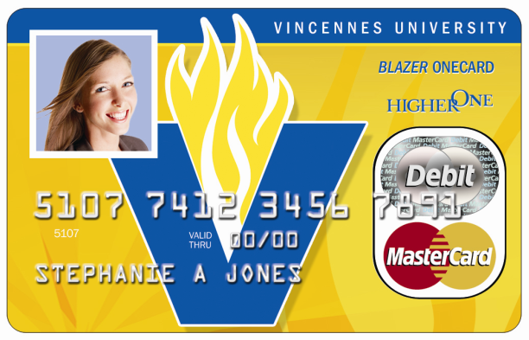
Student Financial Services- BlazerOne Card
Your Student ID with
on-campus functionality:
Dorms, library, bookstore, Student
Recreation Center & activities
Also a debit card if you choose this option
(Walgreen’s ATM charges no fee for cash withdrawal.)
To receive your
BlazerOne Card:
Confirm you address on MyVU
Picture required for on-campus students
Watch your mail for a bright green envelope
Notes:
Template Page – Duplicate and use as needed.

Slide 17
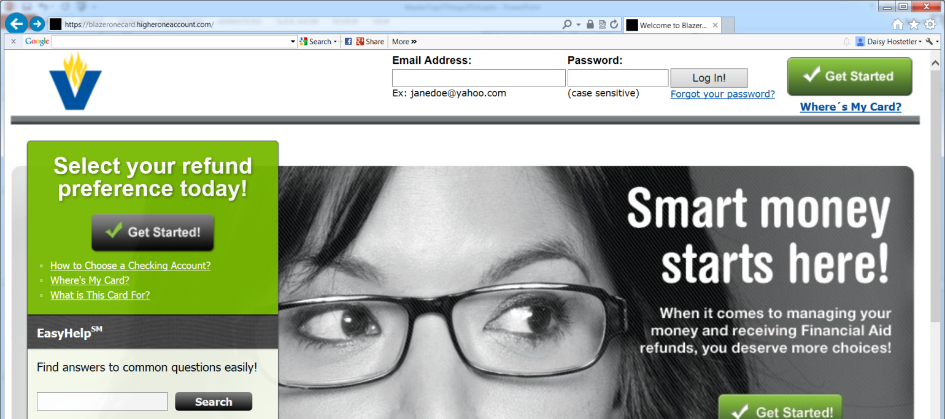
Student Financial Services
Student Financial Services
You must activate your card!
You choose the preference
for any of your refunds at this time.
Activation is MANDATORY;
CHOICE of refunding is your preference!
Notes:
Template Page – Duplicate and use as needed.

Slide 18
Student Financial Services
STUDENT FINANCIAL SERVICES HELP
Student Financial Services representatives available to help!
WHERE: Welsh Administration Bldg.
WHEN: 12:30 PM – 4:00 PM TODAY!
Notes:
Template Page – Duplicate and use as needed.

Slide 19
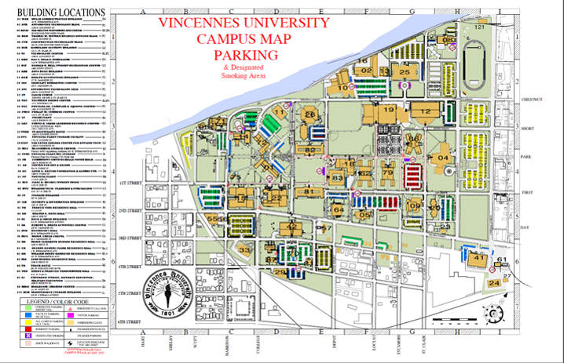
Next Session
Welcome to Campus!
Directions & Parking on Campus
Notes:
Template Page – Duplicate and use as needed.

Slide 20
Parking On Campus
University Parking Permits .
Required for both
Commuter &
Residential Students
Temporary Tags
are also available.
Notes:
Template Page – Duplicate and use as needed.

Slide 21
Next Session
University Housing and
Residential Life
Notes:
Template Page – Duplicate and use as needed.

Slide 22
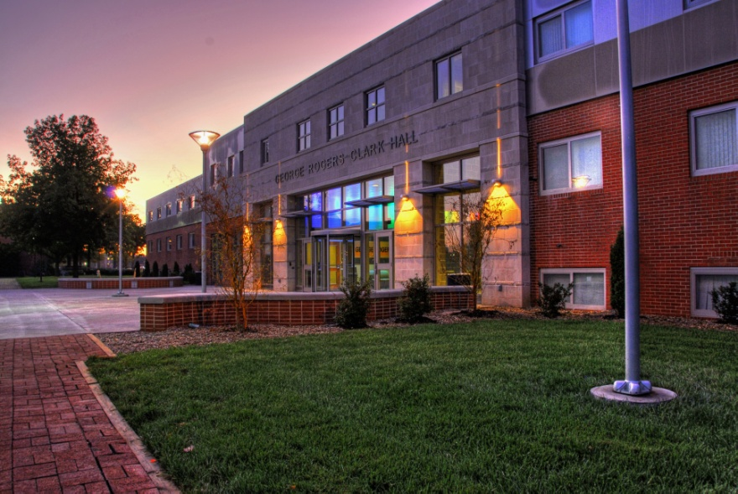
Living On Campus
Housing and
Residential Life
Office located in
Clark Hall, Room 101
812.888.4225
housing@vinu.edu
Notes:
Template Page – Duplicate and use as needed.

Slide 23
Living On Campus
Room Assignments
The Process
Housing Contracts
$150 Deposit
Private Room Options
Room Assignments
Notes:
Template Page – Duplicate and use as needed.

Slide 24
Living On Campus
Housing Requirements
All students are required to live on campus their first year unless they are:
21 Years of Age
Married
Military Veteran
Commuting from Home
Have a Dependent
Notes:
Template Page – Duplicate and use as needed.

Slide 25
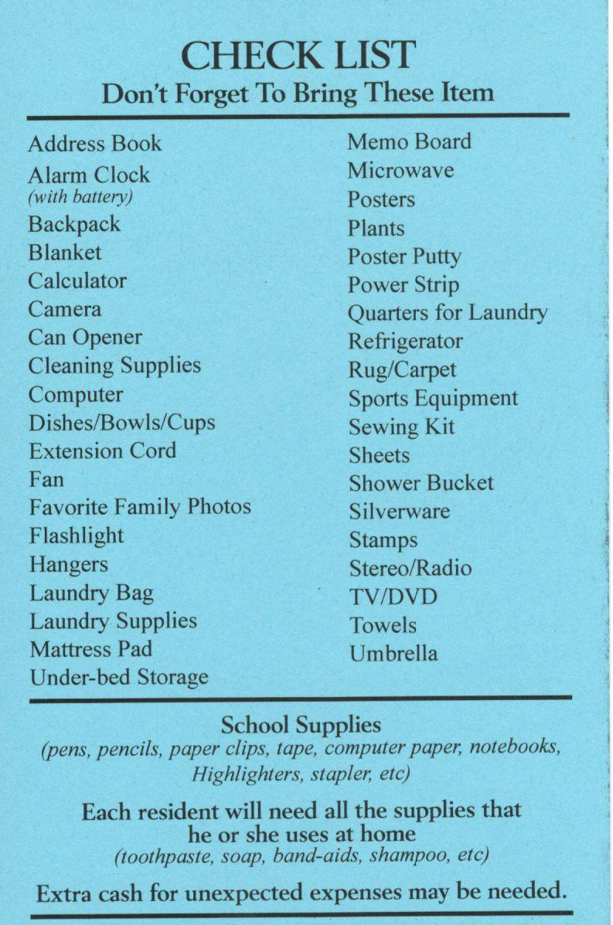
Living On Campus
Residence Hall Handbook
Published Online on July 1, 2017
YOU are responsible
for knowing
this information.
Includes Packing “Do’s and Don’ts”
General Rules and Closing Dates
Notes:
Template Page – Duplicate and use as needed.

Slide 26
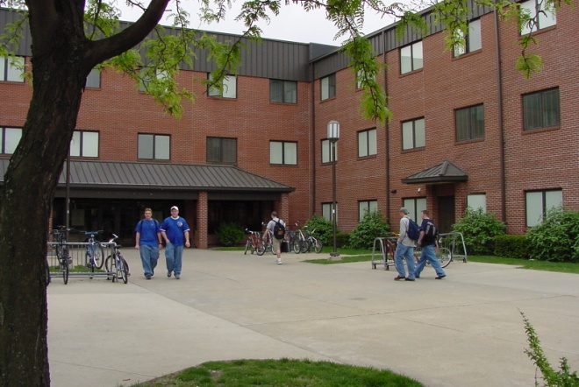
Living On Campus
Showrooms are available for viewing
from 12:00pm-2:00pm today.
Notes:
Template Page – Duplicate and use as needed.

Slide 27
Next Session
Meal Plans and Dining Options Provided By
Notes:
Template Page – Duplicate and use as needed.

Slide 28
Residential Meal Plans
Standard Meal Plans
10 Meal Plan: 10 meals a week
14 Meal Plan: 14 meals a week
19 Meal Plan: 19 meals a week
Flex Meal Plans
10 Meals a week + $250 flex a semester
14 Meals a week + $150 flex a semester
19 Meals a week + $100 flex a semester
Notes:
Template Page – Duplicate and use as needed.

Slide 29
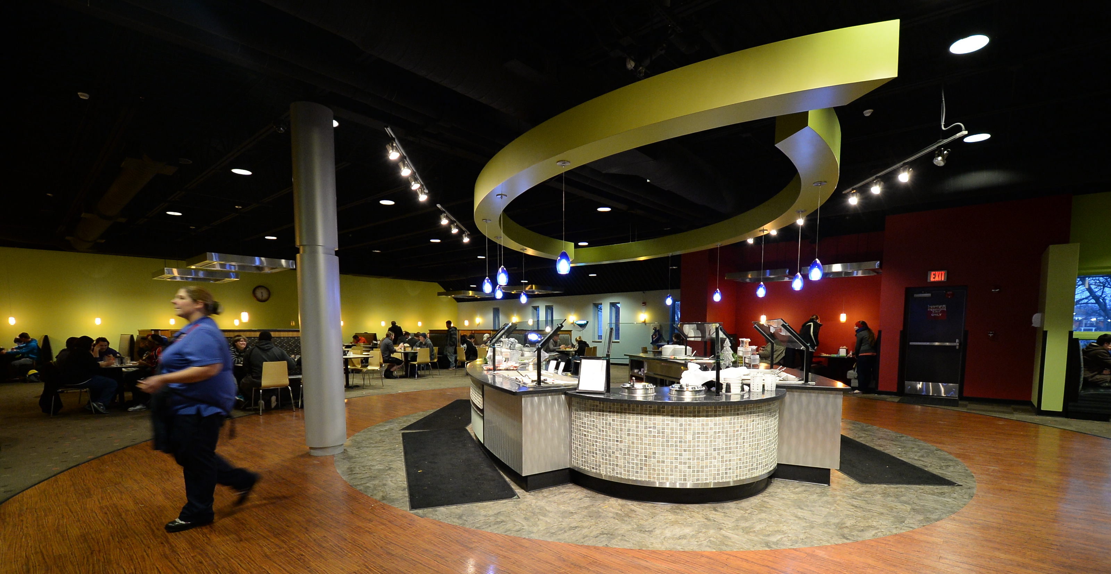
Dining Locations
Meal plans are for Tecumseh Dining Center which serves 19 meal periods per week
Flex Dollars can be used at:
Jefferson Union Cafe Jazzman’s Coffee Shop
Tecumseh Dining Center &
Simply To Go
Notes:
Template Page – Duplicate and use as needed.

Slide 30
Non-Resident Meal Plans
Off Campus and Commuter Students
40 Meals + $200 Flex Dollars
80 Meals + $150 Flex Dollars
160 Meals + $100 Flex Dollars
FREE
VU PARKING PERMIT
with non-resident meal plan purchase!*
These are one time add-ons, but can be purchased as
many times as needed throughout the year.
To purchase meal plans or Flex Dollars:
Call: 812-888-5841 or 812-888-5089,
Visit: www.sodexomyway.com or
if using your financial aid, call the FA Office.
*Permit vouchers can be picked up at TDC.
Notes:
Template Page – Duplicate and use as needed.

Slide 31
vinu.sodexomyway.com
Menus are posted on our website and contain nutritional information.
Special food allergies or special diet needs? Call our Chef to discuss at 812-888-5124.
Notes:
Template Page – Duplicate and use as needed.

Slide 32
Next Session
Next Session
Parent & Family Session
Notes:
Template Page – Duplicate and use as needed.

Slide 33
Parent and Family Services
Defining New Roles
Parent & Family Involvement
Visit Campus – but not too often
Campus Events – Family Weekends, workshops, speakers, concerts, theatre productions, athletic events, fundraisers
Siblings have feelings too!
Start sharing
Picture books and memories
Make them part of the process
– September 16-18
Parent & Family Session
parents@vinu.edu
888-852-3940
812-888-5004
Notes:
Template Page – Duplicate and use as needed.

Slide 34
Parent and Family Services
Big Differences
Not high school
Clarifying values and beliefs
Adjusting to academics
What’s an academic advisor?
Grades are not mailed home
TAPS
The
College
Journey
Notes:
Template Page – Duplicate and use as needed.

Slide 35
Parent and Family Services
Roadmap to Success
Getting Information
Family Education Rights and Privacy Act (FERPA)
Generally, a student’s written consent is necessary before information can be released on a student
Talk to your student TODAY about signing the parental release.
Students Need to Be Prepared
Students need books the first
week of classes
Books are considered an
out-of-pocket expense – Save Now!
Make sure your student signs the Parental Release of Information Form
Notes:
Template Page – Duplicate and use as needed.

Slide 36
Parent and Family Services
Planning Ahead for College Expenses
Out-of-pocket expenses
Books are an out of pocket expense
$300 to $600 average per semester
Try to purchase used books when possible
Textbook Rental Program
Parking Permits $30
(Fall stickers available beginning July 5)
Tools $$$
Art Supplies $$
Visit the VU Bookstore Today!
Notes:
Template Page – Duplicate and use as needed.

Slide 37
Parent and Family Services
What does it cover?
What does the money pay for?
In this order
Tuition and academic fees
Student Activity fee
Housing
Books
IMPORTANT: Books can only be charged to the student account IF there is enough accepted financial aid!
Notes:
Template Page – Duplicate and use as needed.

Slide 38
Parent and Family Services
GET
INVOLVED!
Living On Campus
Benefits
Halls staffed 24/7
Furnished rooms
Each student has a desk, dresser, closet, and bed (extra long twin)
Meal Plan
Walking distance
Resources close by
Challenges
Homesickness
Roommates
Time Management
Getting to class
Doing homework
Laundry
Making new friends
Making good decisions
Notes:
Template Page – Duplicate and use as needed.

Slide 39
Parent and Family Services
GET
INVOLVED!
Commuting From Home
60% live at home or off campus Schedules will change
Benefits
Can work
Closer to family
Bring new friends home
Know community
Less likely to become homesick
Challenges
Can work
Difficulty finding “their place”
Family Dynamic
Study time/Resources
Parking
Transportation
Participation in events
Notes:
Template Page – Duplicate and use as needed.

Slide 40
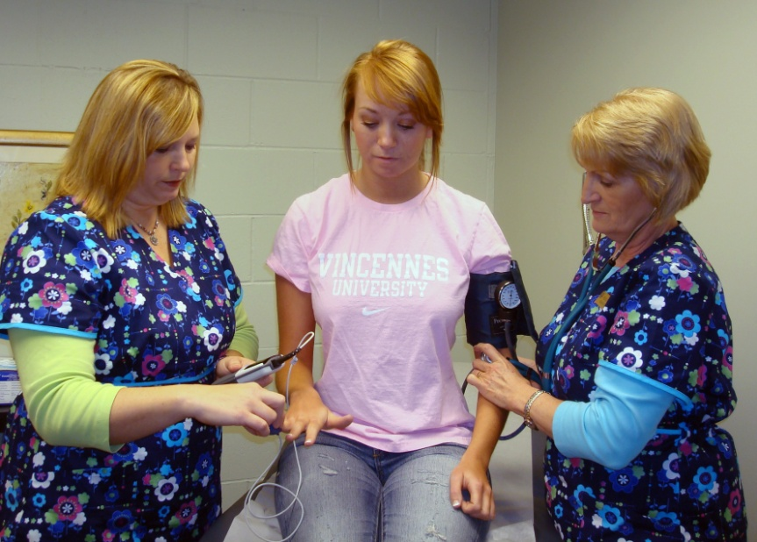
Parent and Family Services
VU Health Services:
UPCC - University Primary Care Center
Located in the Young Building (4th and College St.)
Nurse Practitioner and Nursing Staff
Resident Hall students cannot opt out of UPCC
Off campus students and commuter
students can opt out of UPCC
Notes:
Template Page – Duplicate and use as needed.

Slide 41
Parent and Family Services
Immunization Records:
Laws and Records on File
Immunization Laws
2- Measles vaccines
1- MMR
1- Tetanus/Diphtheria
Meningitis shot or waiver
Health Occupations
Child Care Majors
EMS
Fire Science
Physical including TB test
Recommended
Hepatitis B series
Chickenpox vaccine
If your student does NOT submit the appropriate immunizations, there will be a registration hold placed on their account!
Questions: See me!
Notes:
Template Page – Duplicate and use as needed.

Slide 42
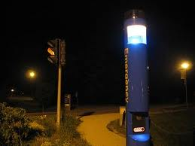
Parent and Family Services
Campus Safety
Fully Empowered Police Department
Provide help
Enforce the law
Provide student escorts
Facilitate crime prevention seminars
Safety is everyone’s responsibility
Record valuables
Keep doors locked
Keep medicine out of sight
Student should sign up for Emergency Notifications (E-text) at MyVU.vinu.edu
Notes:
Template Page – Duplicate and use as needed.

Slide 43
Parent and Family Services
Notes:
Template Page – Duplicate and use as needed.

Slide 44
Parent and Family Services
Looking for Resources?
Look to the VU Web Pages for Information
General Information
Upcoming Events/Programs
Critical Announcements
Join the E-newsletter
Know what’s going on!
Join PFS Facebook Group
Facebook.com/groups/vuparents
Contact Parent & Family Services
FAQ’s in PFS Calendar
vinu.edu/parents
parents@vinu.edu
888-852-3940
812-888-5004
Notes:
Template Page – Duplicate and use as needed.

Slide 45
Notes:
Opening Graphic

