Slide 1
Welcome!
Parent & Family Session

Slide 2
Defining New Roles
– September 16-18
Parent & Family Involvement
Visit Campus – but not too often
Campus Events – Family Weekends, workshops, speakers, concerts, theatre productions, athletic events, fundraisers
Siblings have feelings too!
Start sharing
Picture books and memories
Make them part of the process
parents@vinu.edu
888-852-3940
812-888-5004

Slide 3
The College Journey
Big Differences
Not high school
Clarifying values and beliefs
Adjusting to academics
What’s an academic advisor?
Grades are not mailed home
TAPS

Slide 4
Roadmap to Success
Getting Information
Family Education Rights and Privacy Act (FERPA)
Generally, a student’s written consent is necessary before information can be released on a student
Talk to your student TODAY about signing the parental release.
Students Need to Be Prepared
Students need books the first
week of classes
Books are considered an
out-of-pocket expense –
Save Now!
Make sure your student signs the Parental Release of Information Form

Slide 5
All About the Money
Out-of-pocket expenses
Books are an out of pocket expense
$300 to $600 average per semester
Try to purchase used books when possible
Textbook Rental Program
Parking Permits $30
(Fall stickers available beginning July 5)
Tools $$$
Art Supplies $$
Visit the VU Bookstore Today!

Slide 6
All About the Money
What does the money pay for?
In this order
Tuition and academic fees
Student Activity fee
Housing
Books
IMPORTANT: Books can only be charged to the student account IF there is enough accepted financial aid!

Slide 7
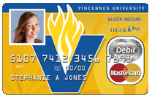
All About the Money
BlazerOne Card
This is your student’s ID
Student refunds-Student must activate their card
Refund can be put on card or check can be mailed
24 hour access
ATM available at Walgreen’s on 6th and College St.
Check it out at BlazerOneCard.com
Backed by MasterCard®

Slide 8
All About the Money
Dropping and Adding Classes
Drop and Add Week = 100%
75% second week
50% third week
25% fourth week
0% thereafter
Drop Deadline
Students MUST see an advisor to drop a class. Simply not going to class may result in a failed grade.

Slide 9
Living On Campus
Benefits
Halls staffed 24/7
Furnished rooms
Each student has a desk, dresser, closet, and bed (extra long twin)
Meal Plan
Walking distance
Resources close by
Challenges
Homesickness
Roommates
Time Management
Getting to class
Doing homework
Laundry
Making new friends
Making good decisions
GET INVOLVED!

Slide 10
Commuting From Home
60% Live at home or off campus
Schedules will change
Benefits
Can work
Closer to family
Bring new friends home
Know community
Less likely to become homesick
Challenges
Can work
Difficulty finding “their place”
Family Dynamic
Study time/Resources
Parking
Transportation
Participation in events
GET INVOLVED!

Slide 11
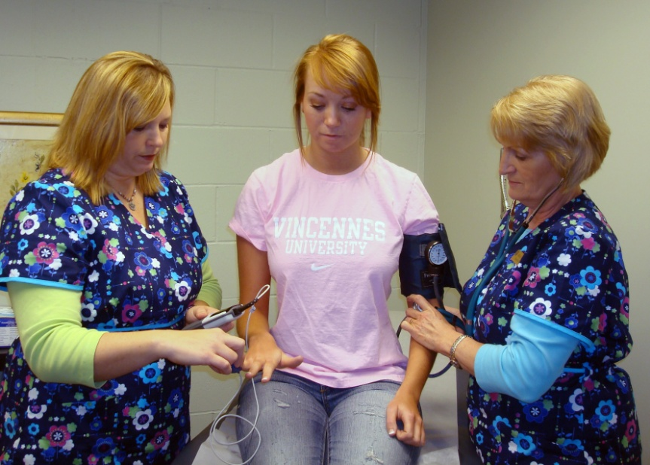
VU Health Services: UPCC - University Primary Care Center
Located at the Young Building at the Corner of 4th and College Street
Health Center with Nurse Practitioner and Nursing Staff
Resident Hall students
can’t opt out of UPCC
Off campus students/
commuter students
can opt out of UPCC

Slide 12
VU Health Services: UPCC - University Primary Care Center
Immunization Laws
2- Measles vaccines
1- MMR
1- Tetanus/Diphtheria
Meningitis shot or waiver
Health Occupations
Child Care Majors
EMS
Fire Science
Physical including TB test
Recommended
Hepatitis B series
Chickenpox vaccine
If your student does NOT submit the appropriate immunizations, there will be a registration hold placed on their account! Questions: See me!

Slide 13
Campus Safety
Fully Empowered Police Department
Provide help
Enforce the law
Provide student escorts
Facilitate crime prevention seminars
Safety is everyone’s responsibility
Record valuables
Keep doors locked
Keep medicine out of sight
Student should sign up for Emergency Notifications (ETEXT) at MyVU.vinu.edu

Slide 14
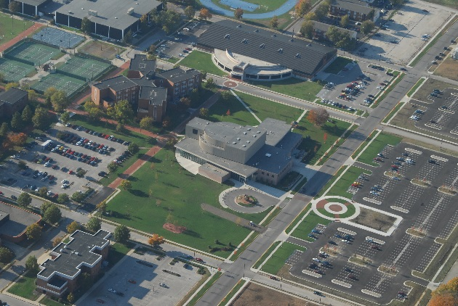
Campus Safety
Mail
Students share a mailbox
If you are sending money or packages please let student know in advance
Call front desk
Parking
Not in front of residence halls
Tickets are issued
Must have permit

Slide 15
Voices United
Initiated in Partnership with
Whitehouse “It’s on Us” Campaign.
End Sexual Violence
Programming to bring student awareness
Events
Red Flag Campaign
Denim Day
More Information at https://www.vinu.edu/web/guest/itsonus

Slide 16
Looking for Resources?
Look to the VU Web Pages for Information
General Information
Upcoming Events/Programs
Critical Announcements
Join the E-newsletter
Know what’s going on!
Join PFS Facebook Group
Facebook.com/groups/vuparents
Contact Parent & Family Services
FAQ’s in PFS Calendar
parents@vinu.edu
888-852-3940
812-888-5004
vinu.edu/parents

Slide 17
Start of School
Know your advisor!
Thursday, August 17– Residence Halls open 8:00 am
(You do not have to arrive on this day!)
Friday, August 18- New Student Orientation (Parents and Family Members are highly encouraged to attend!)
Monday, August 22- CLASSES BEGIN!!!
Monday, August 22 – Friday, August 25 – 100% Drop/Add
ALL students and Academic Advisors have access to Degree Works. Utilize this tool every time you meet with your academic advisor to schedule your classes. This will ensure you are on track to fulfill your graduation requirements.
Watch for Back to School Letter
Questions?

